Slide 1
November 2022
SC-OR Influent Pump Station Project

Slide 2
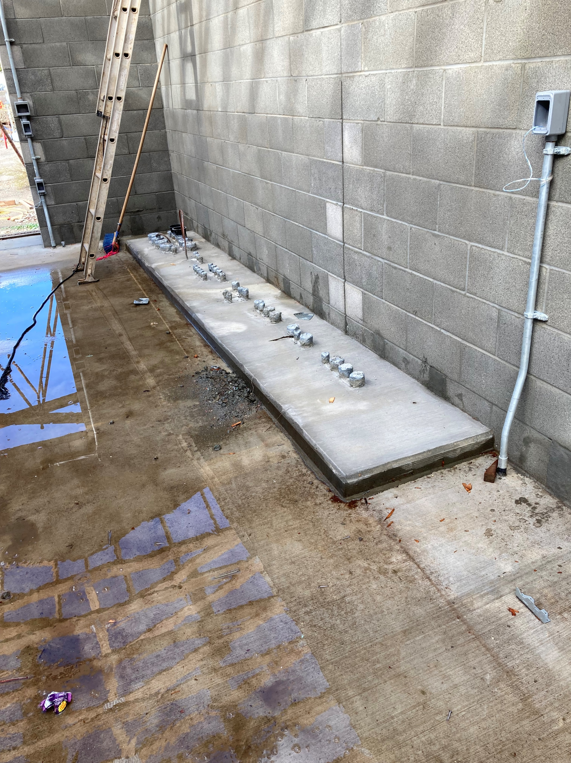
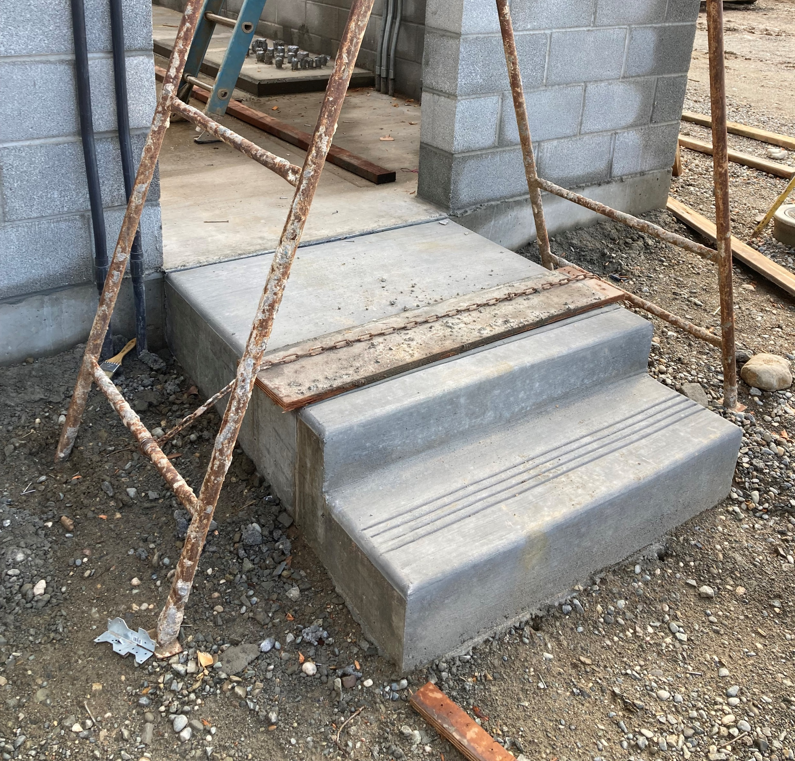
Motor Control Pads and Entryways of Electrical Building

Slide 3
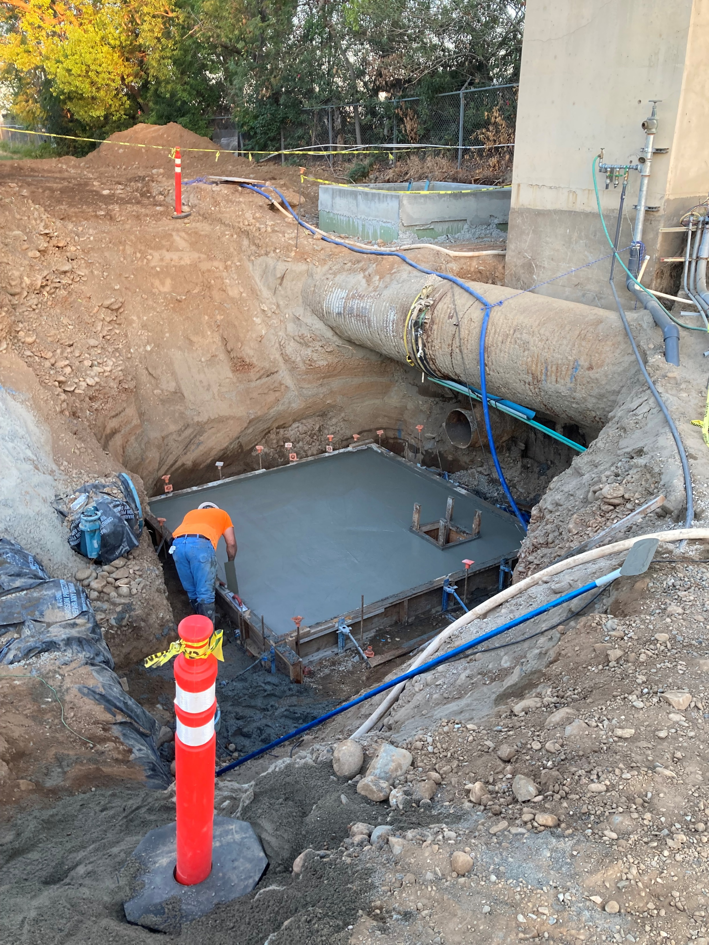
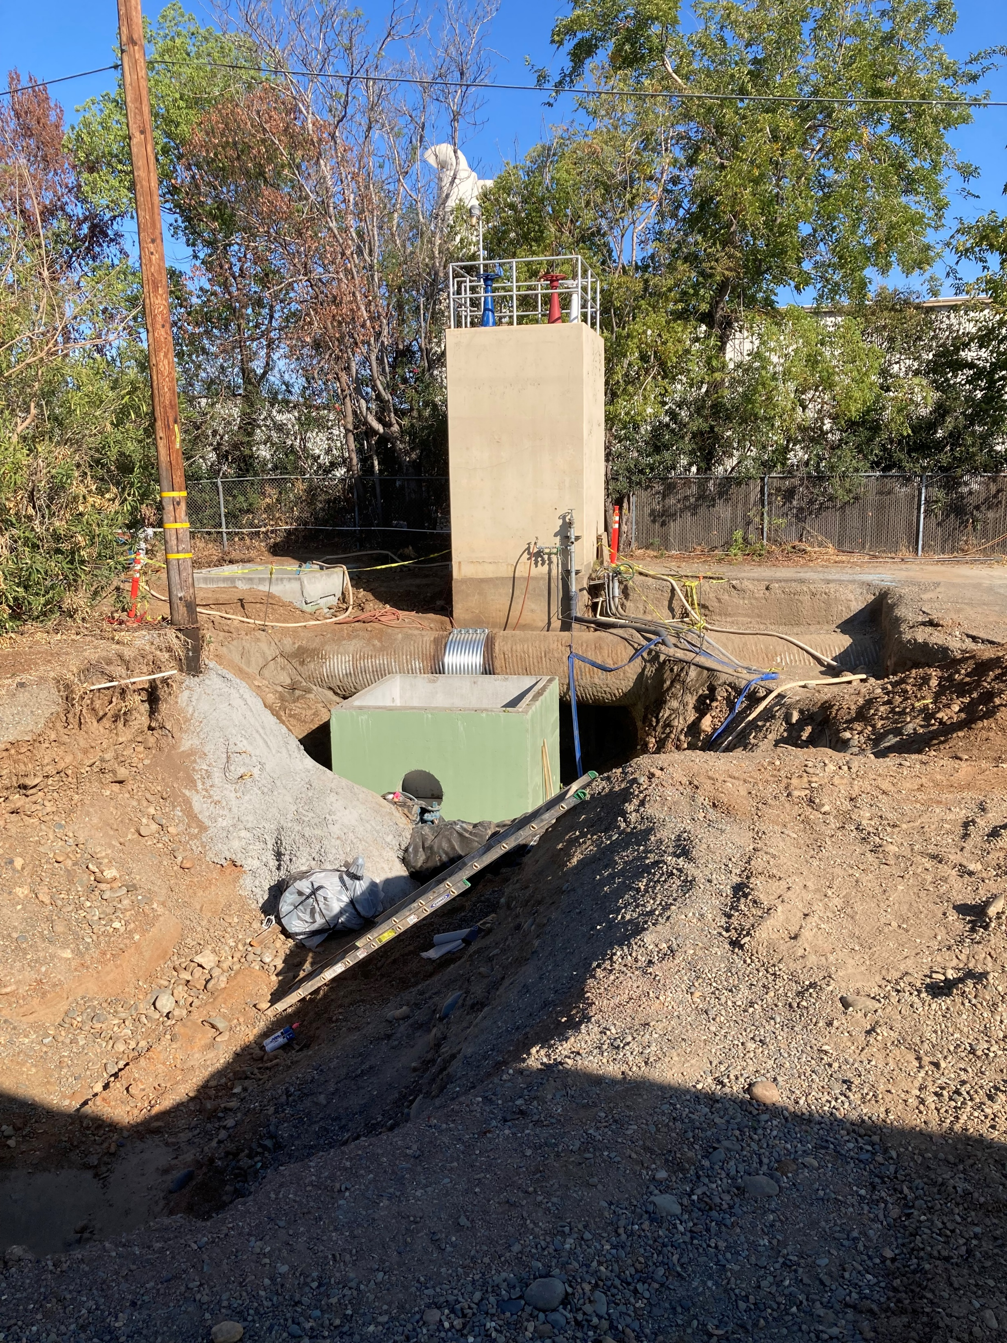
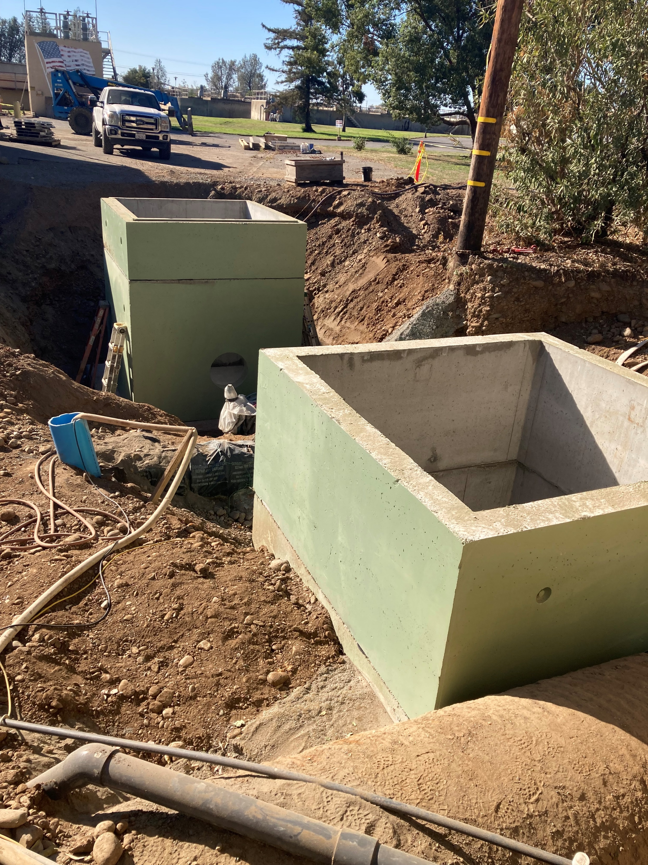
Actuating Valve, Flow Meter Vaults and Pipework

