Slide 1
December 2021
SC-OR Influent Pump Station Project

Slide 2
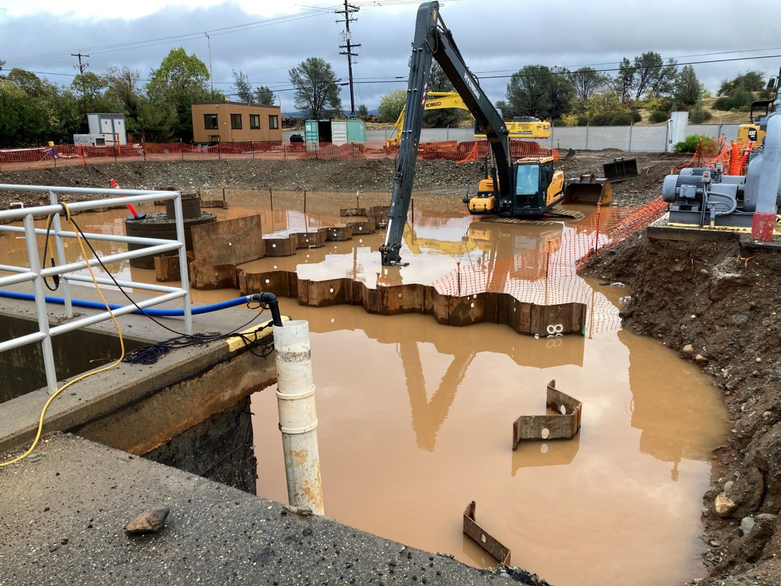
December 2021 Rains

Slide 3
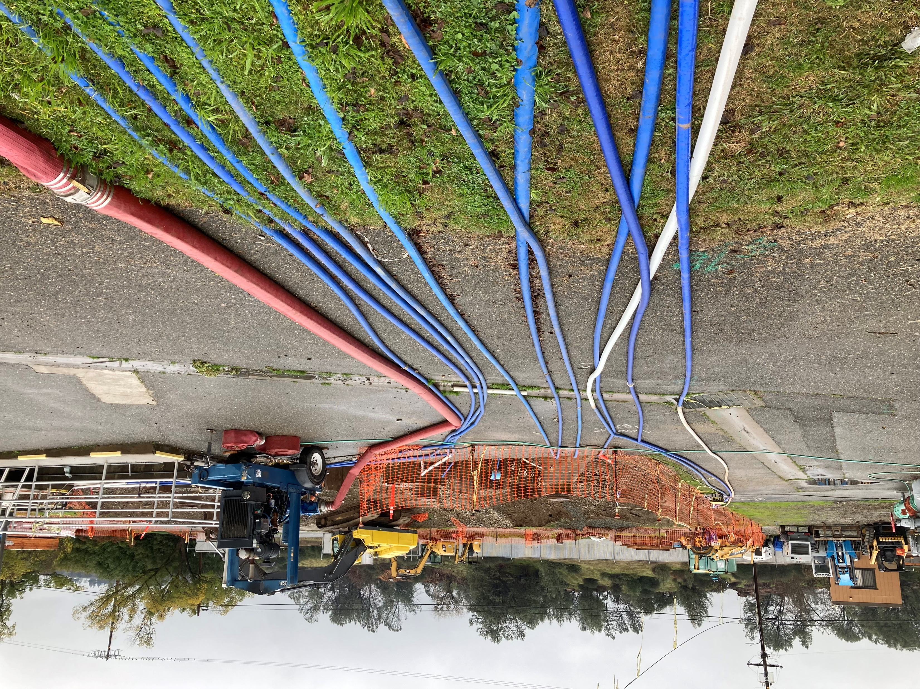
Dewatering in December

Slide 4
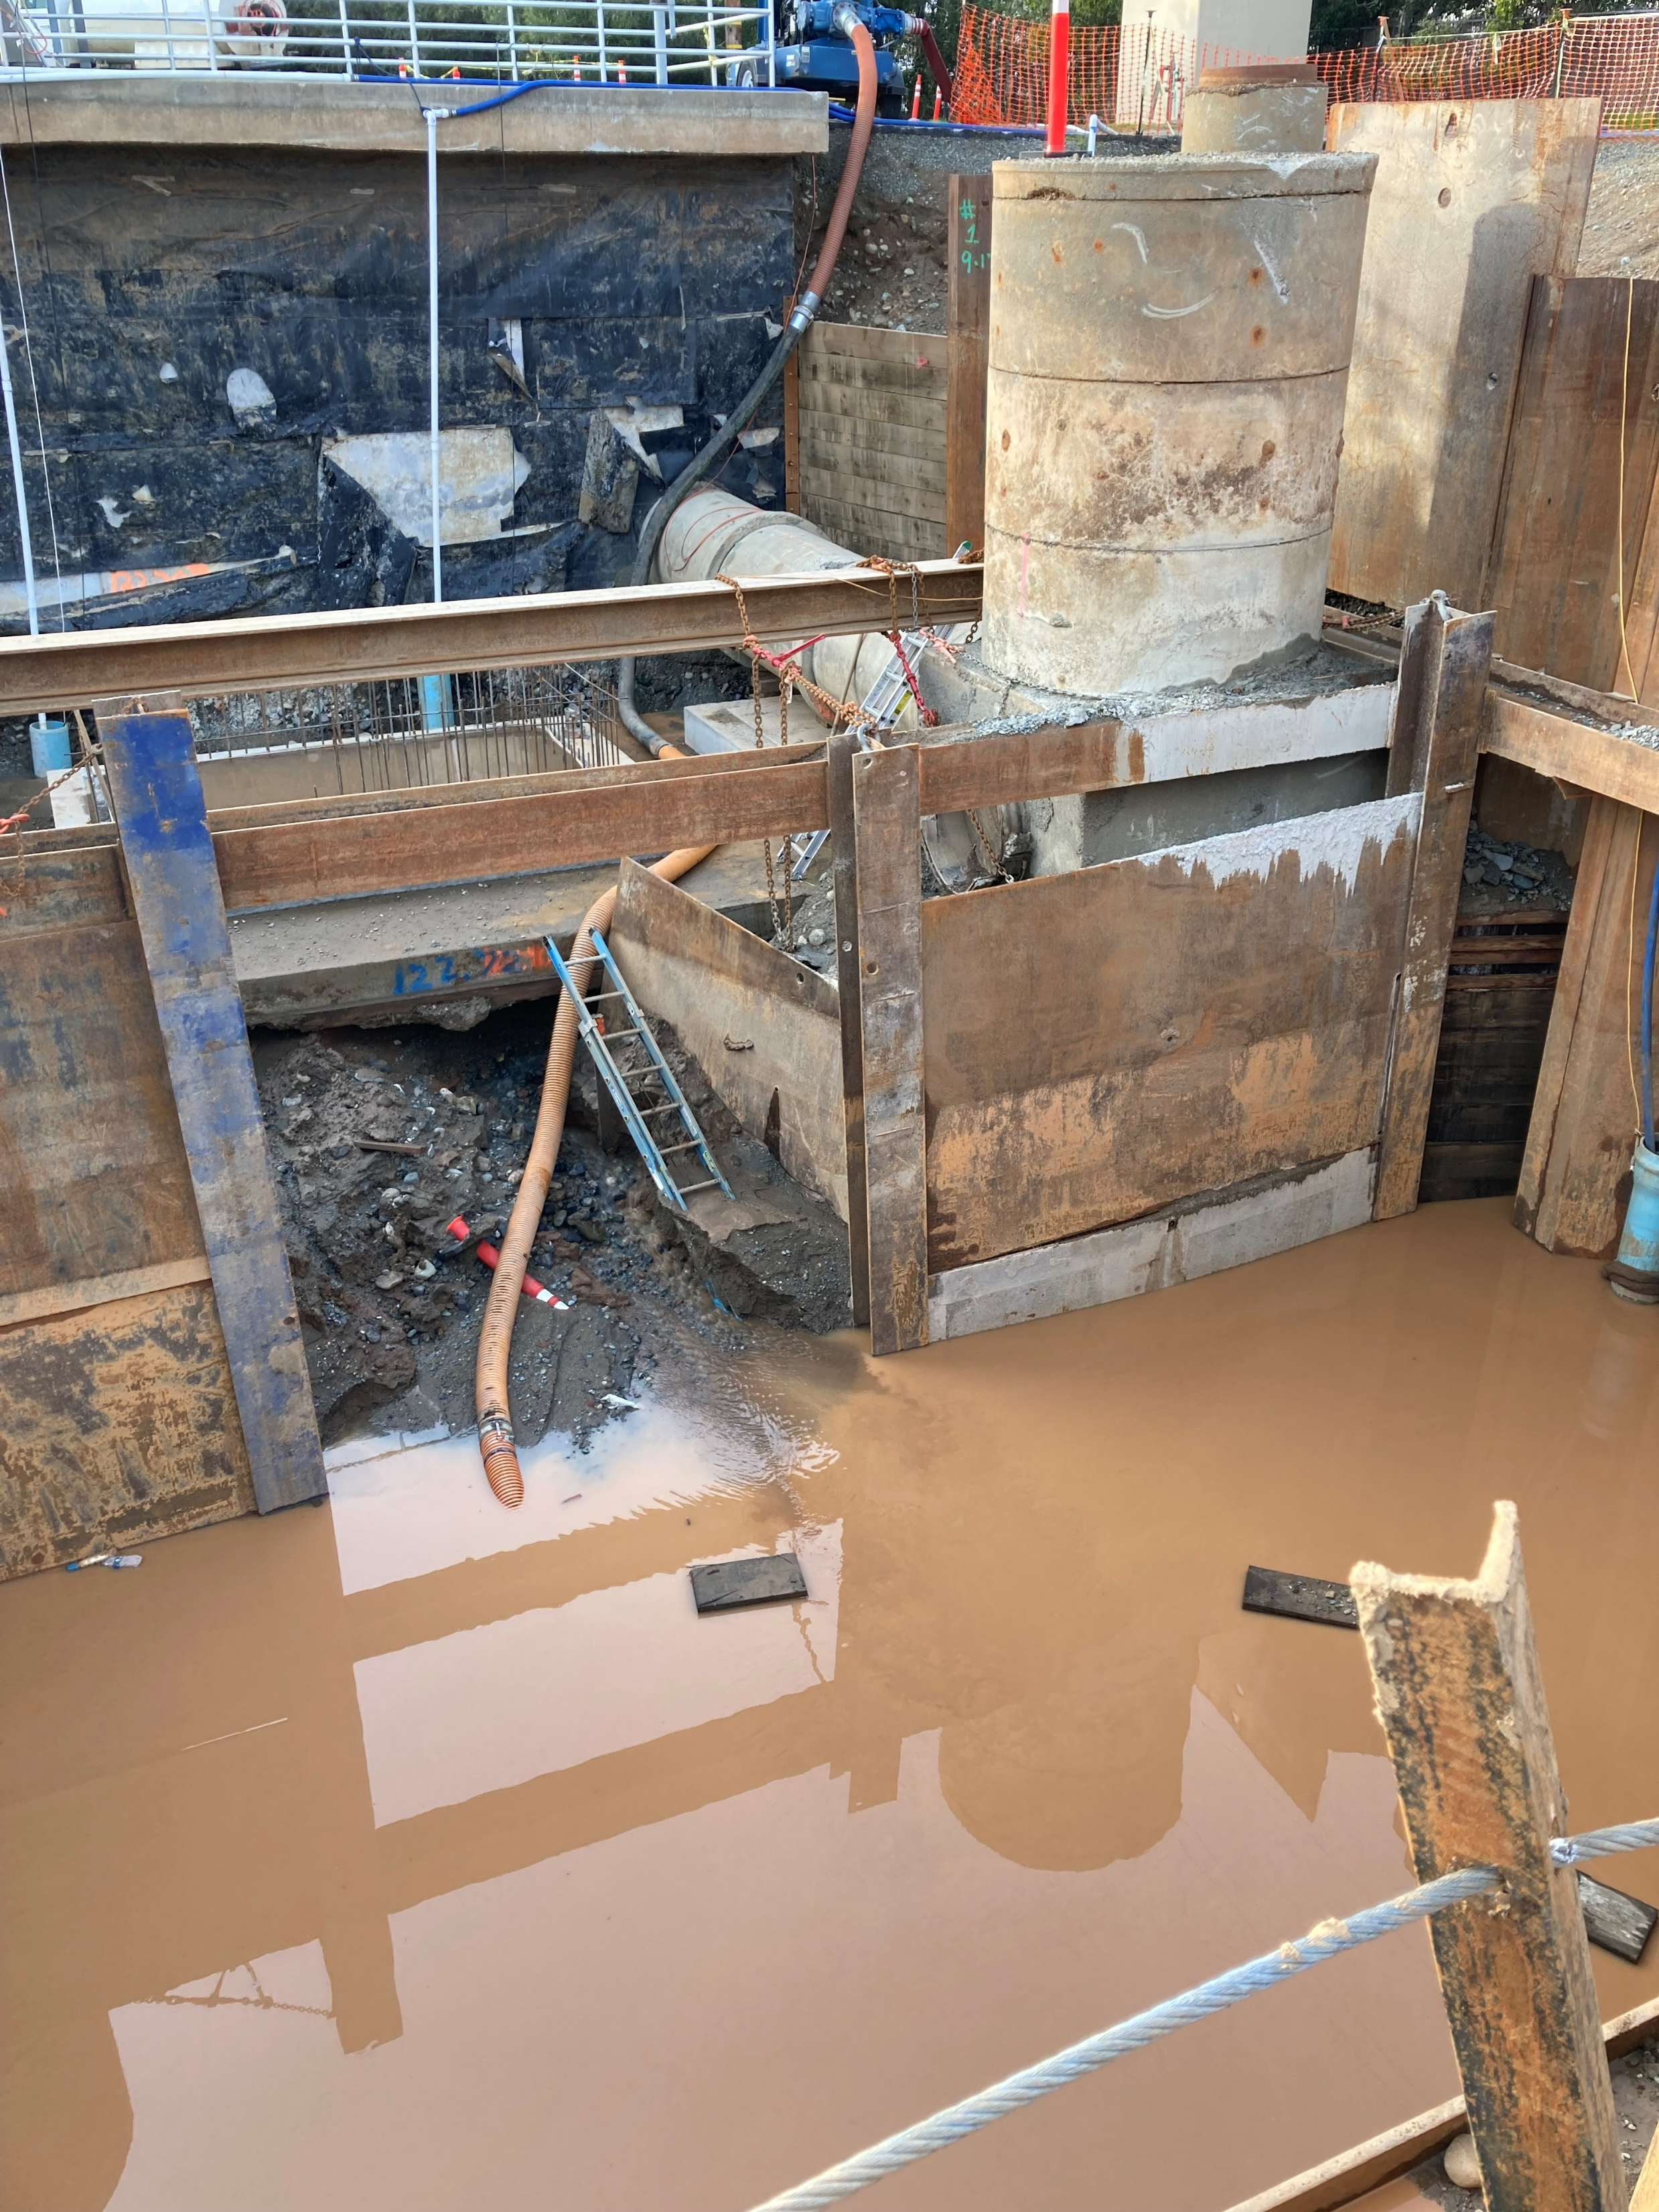

Slide 5
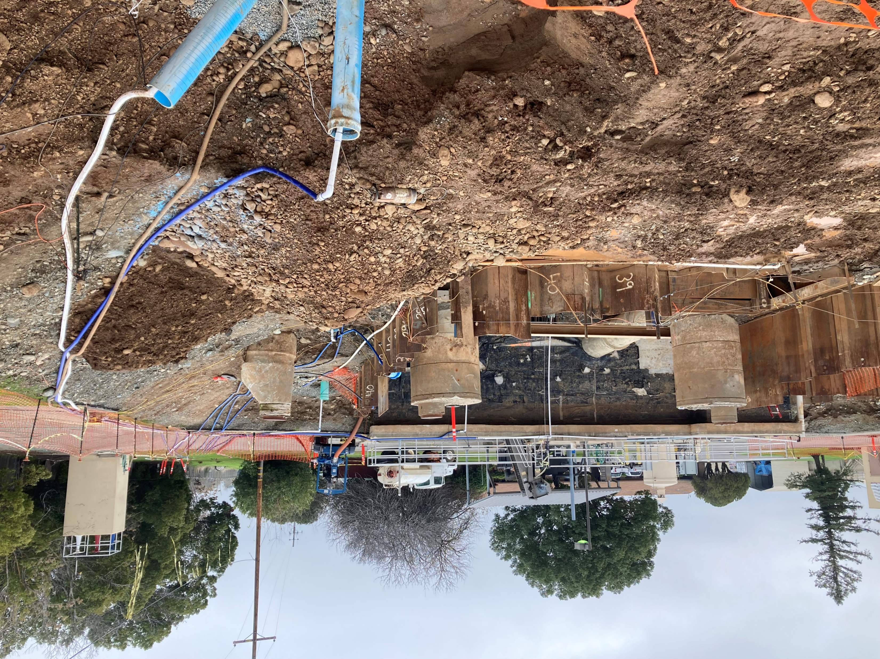
Dewatering Wells

Slide 6
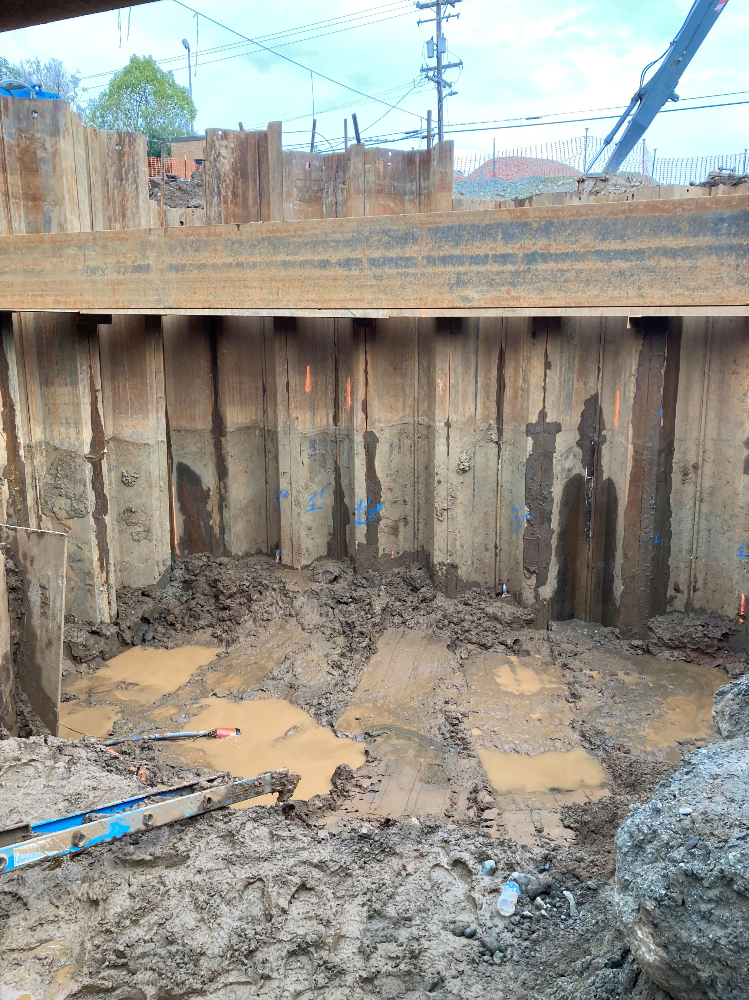
Mud

