Slide 1
March 2022
SC-OR Influent Pump Station Project

Slide 2
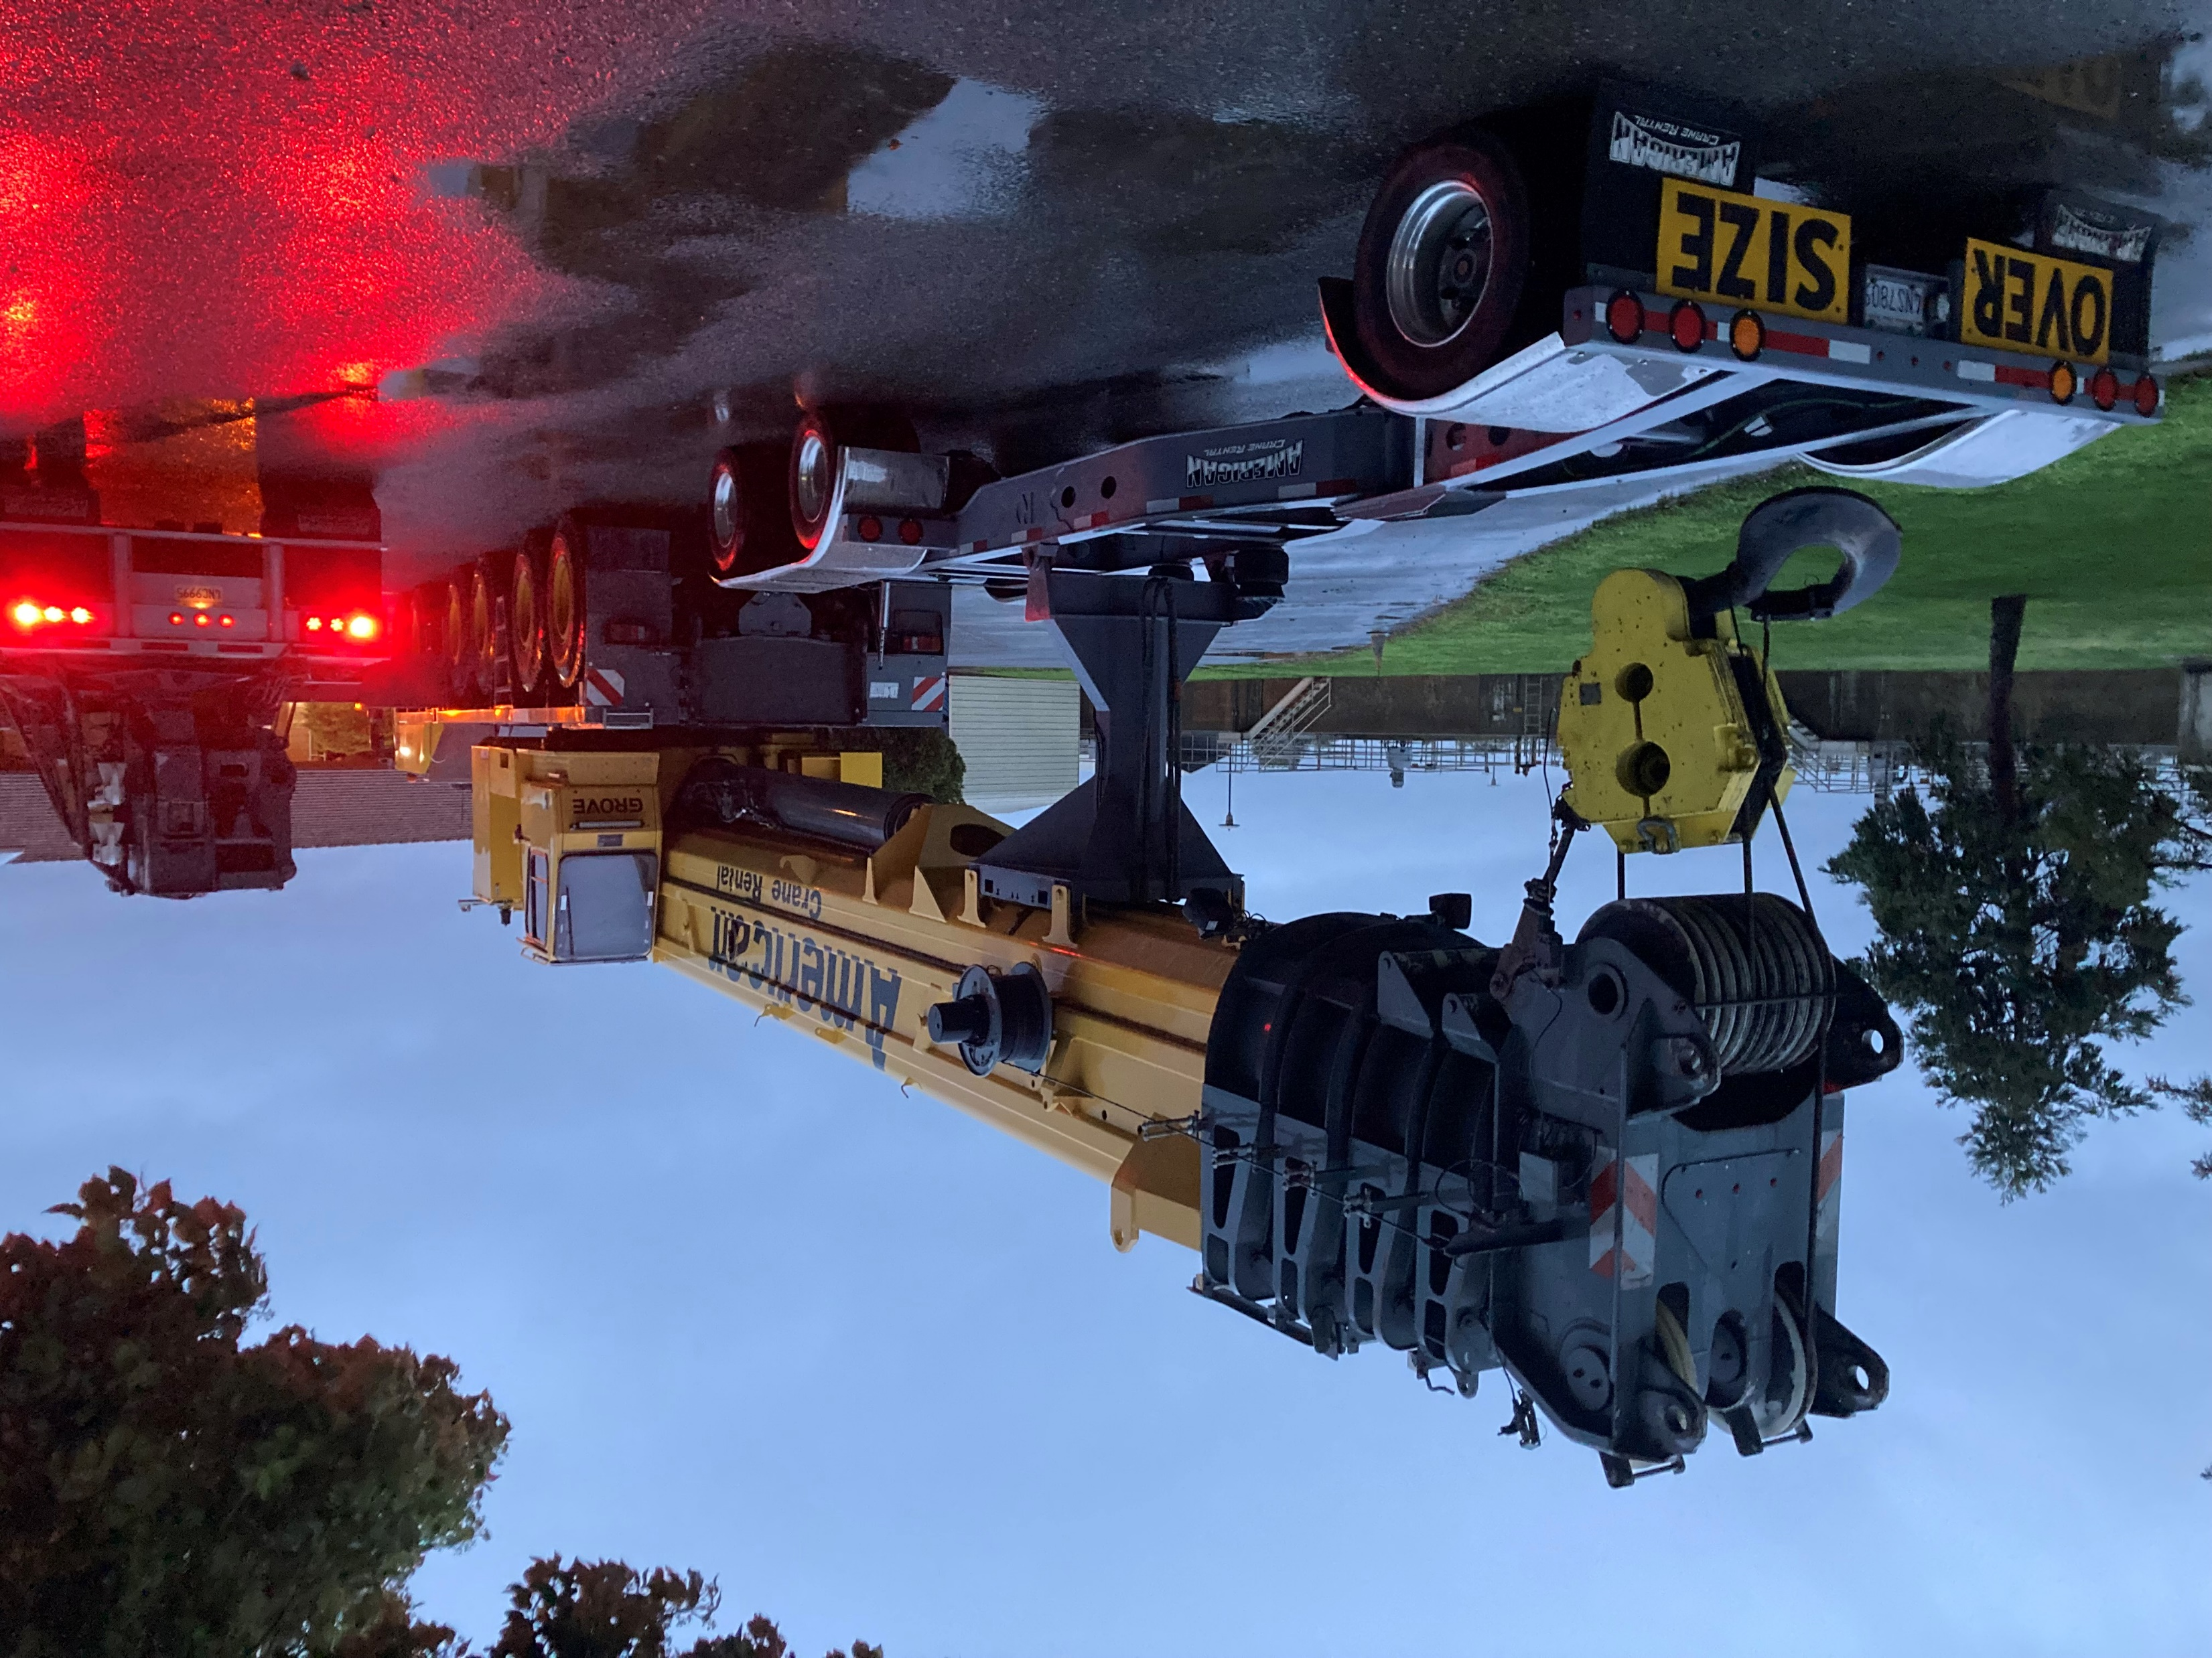
Big Crain

Slide 3
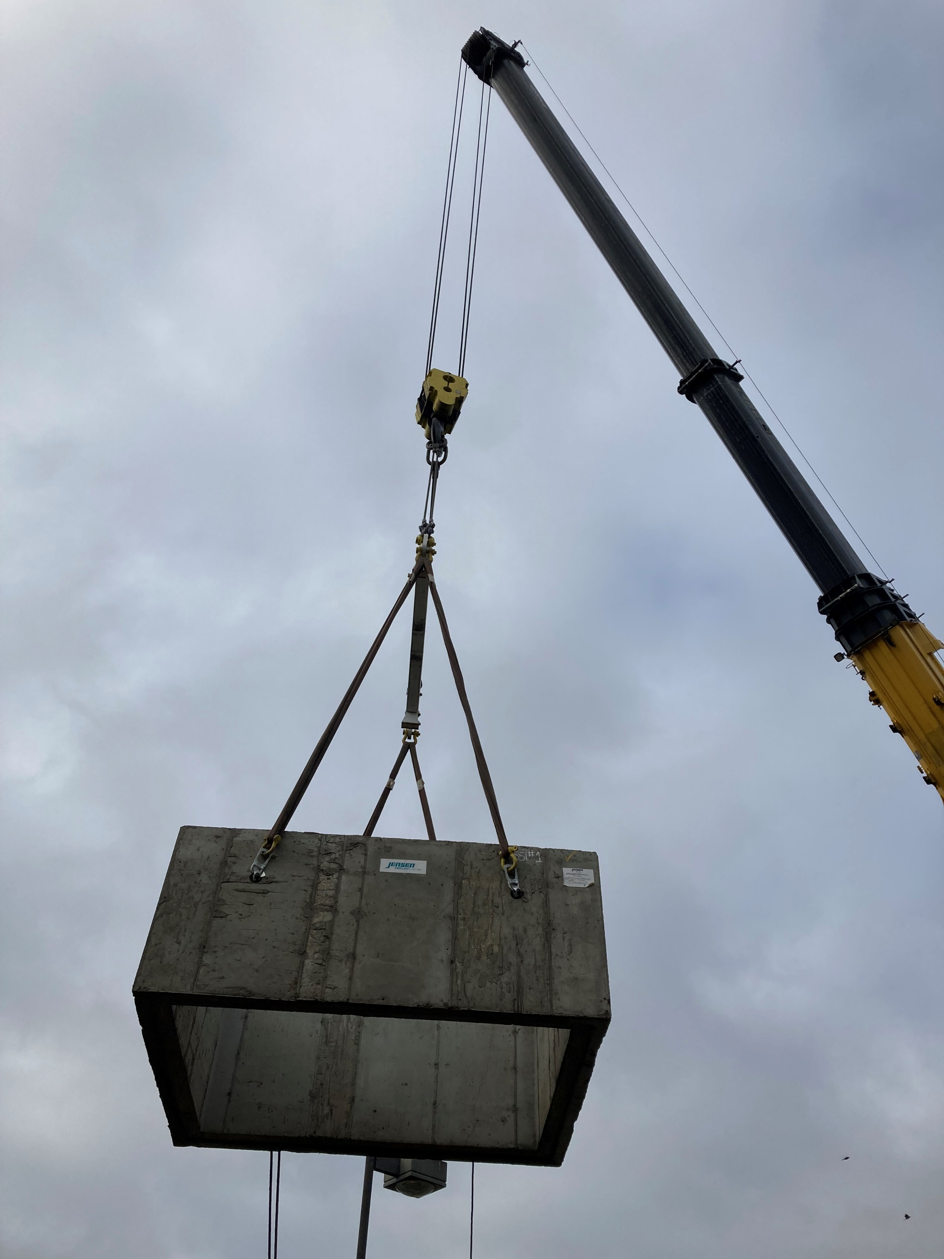
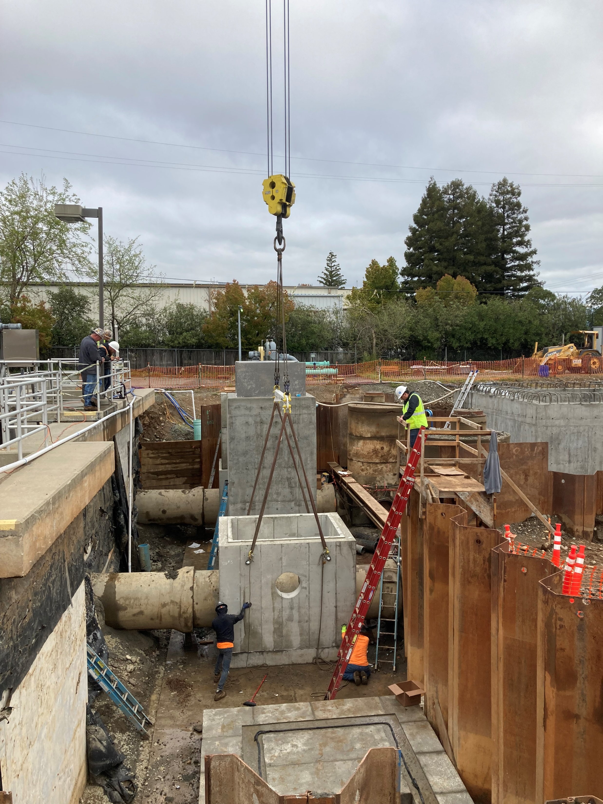
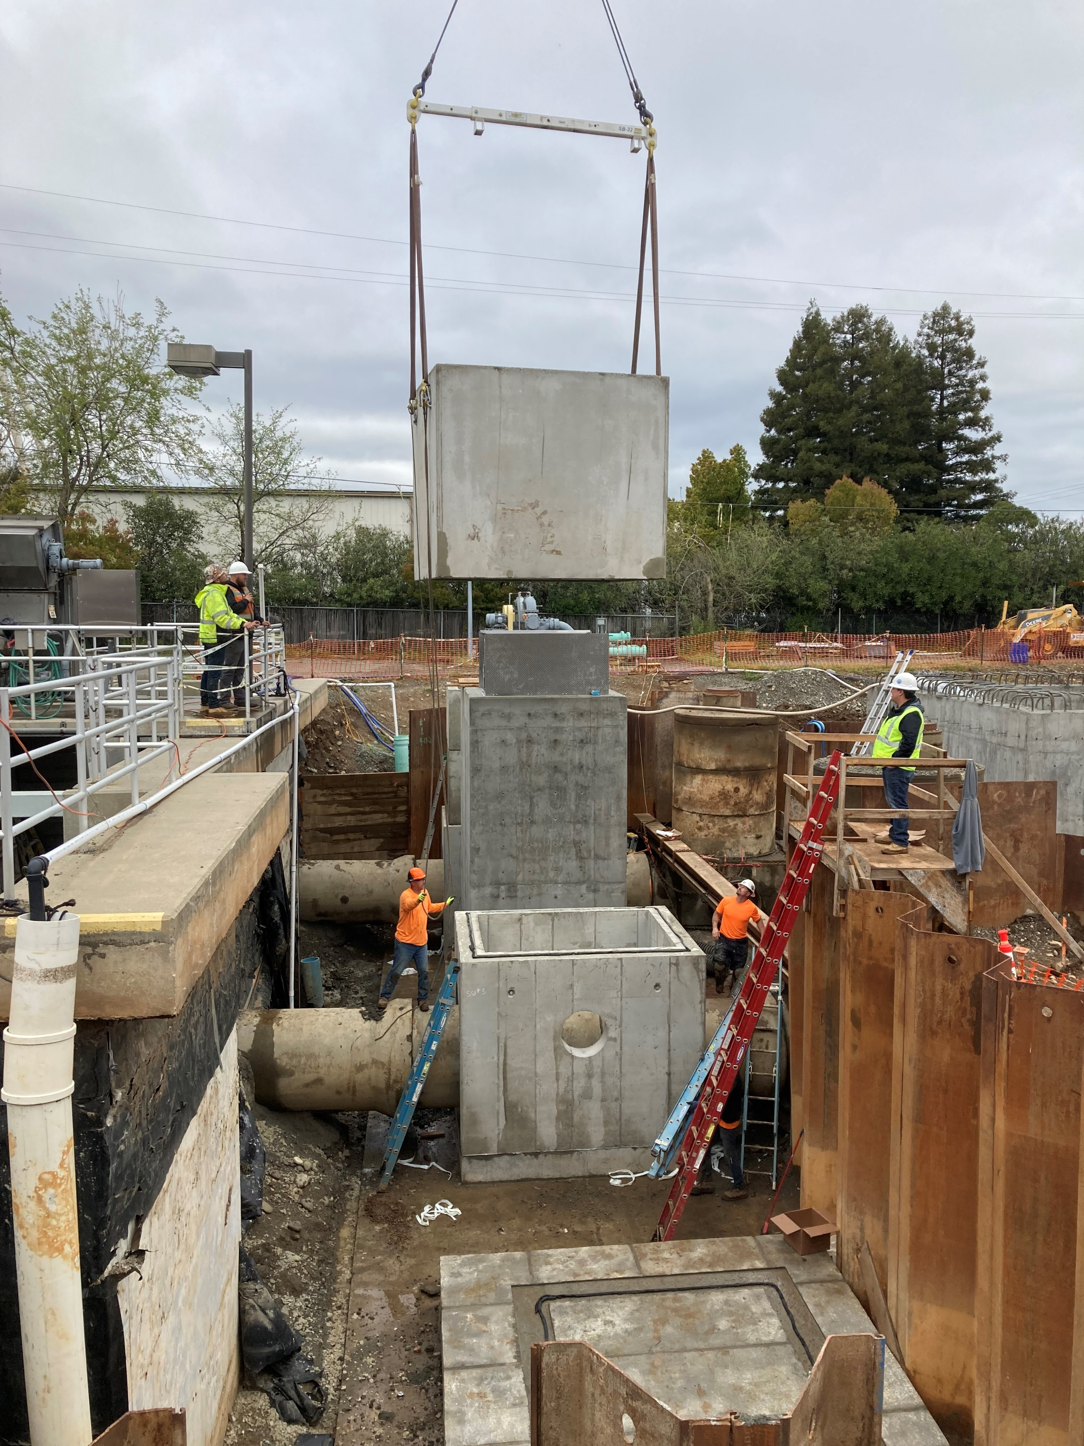
Flying In Precast Concrete Blocks To Build New Valve And Flow Meter Vaults

Slide 4
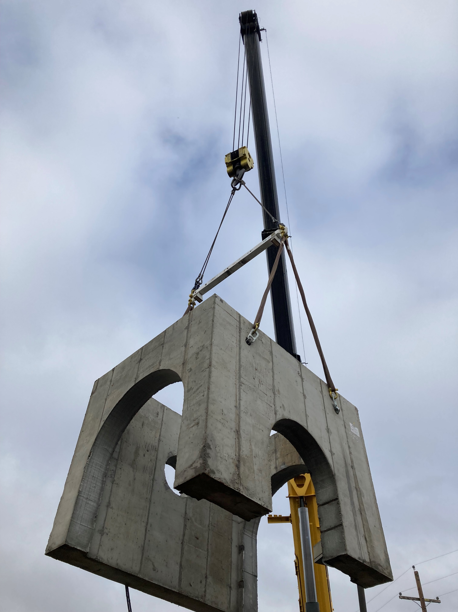
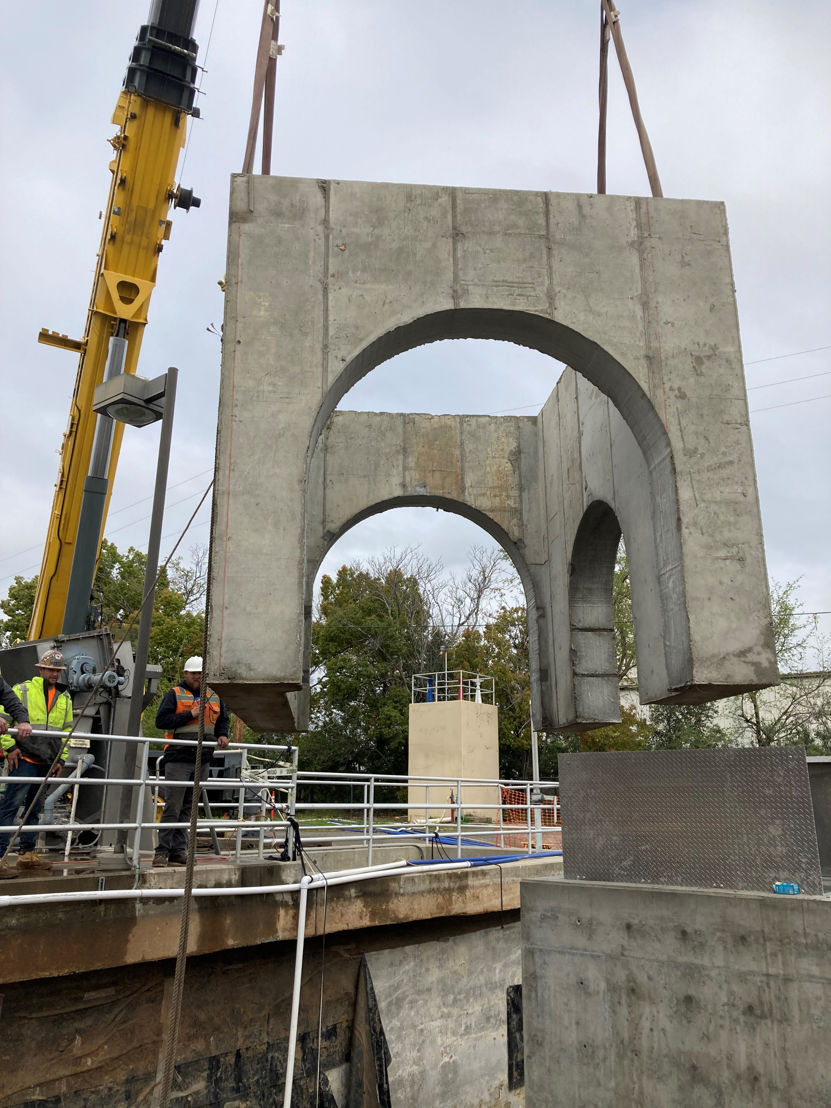
Flying In Precast Blocks With Mouse Holes To Build Over Existing Pipes

Slide 5
Preparing The First Layer For The Second Layer Of Precast Concrete Using Sealant

Slide 6
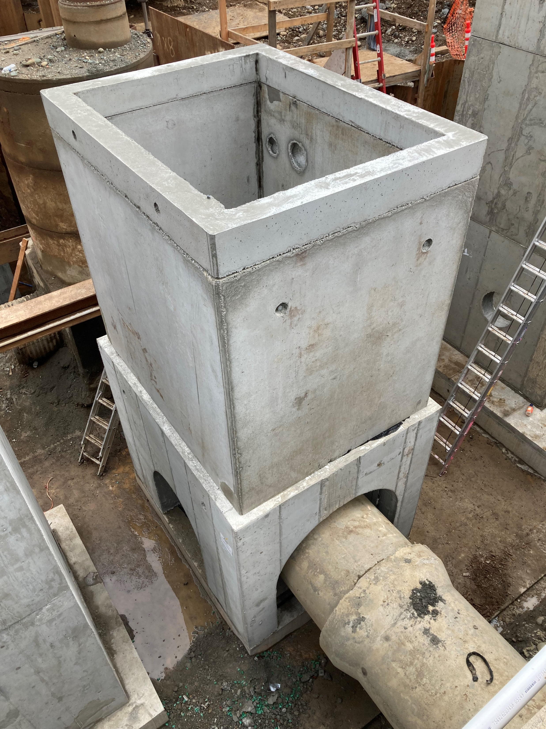
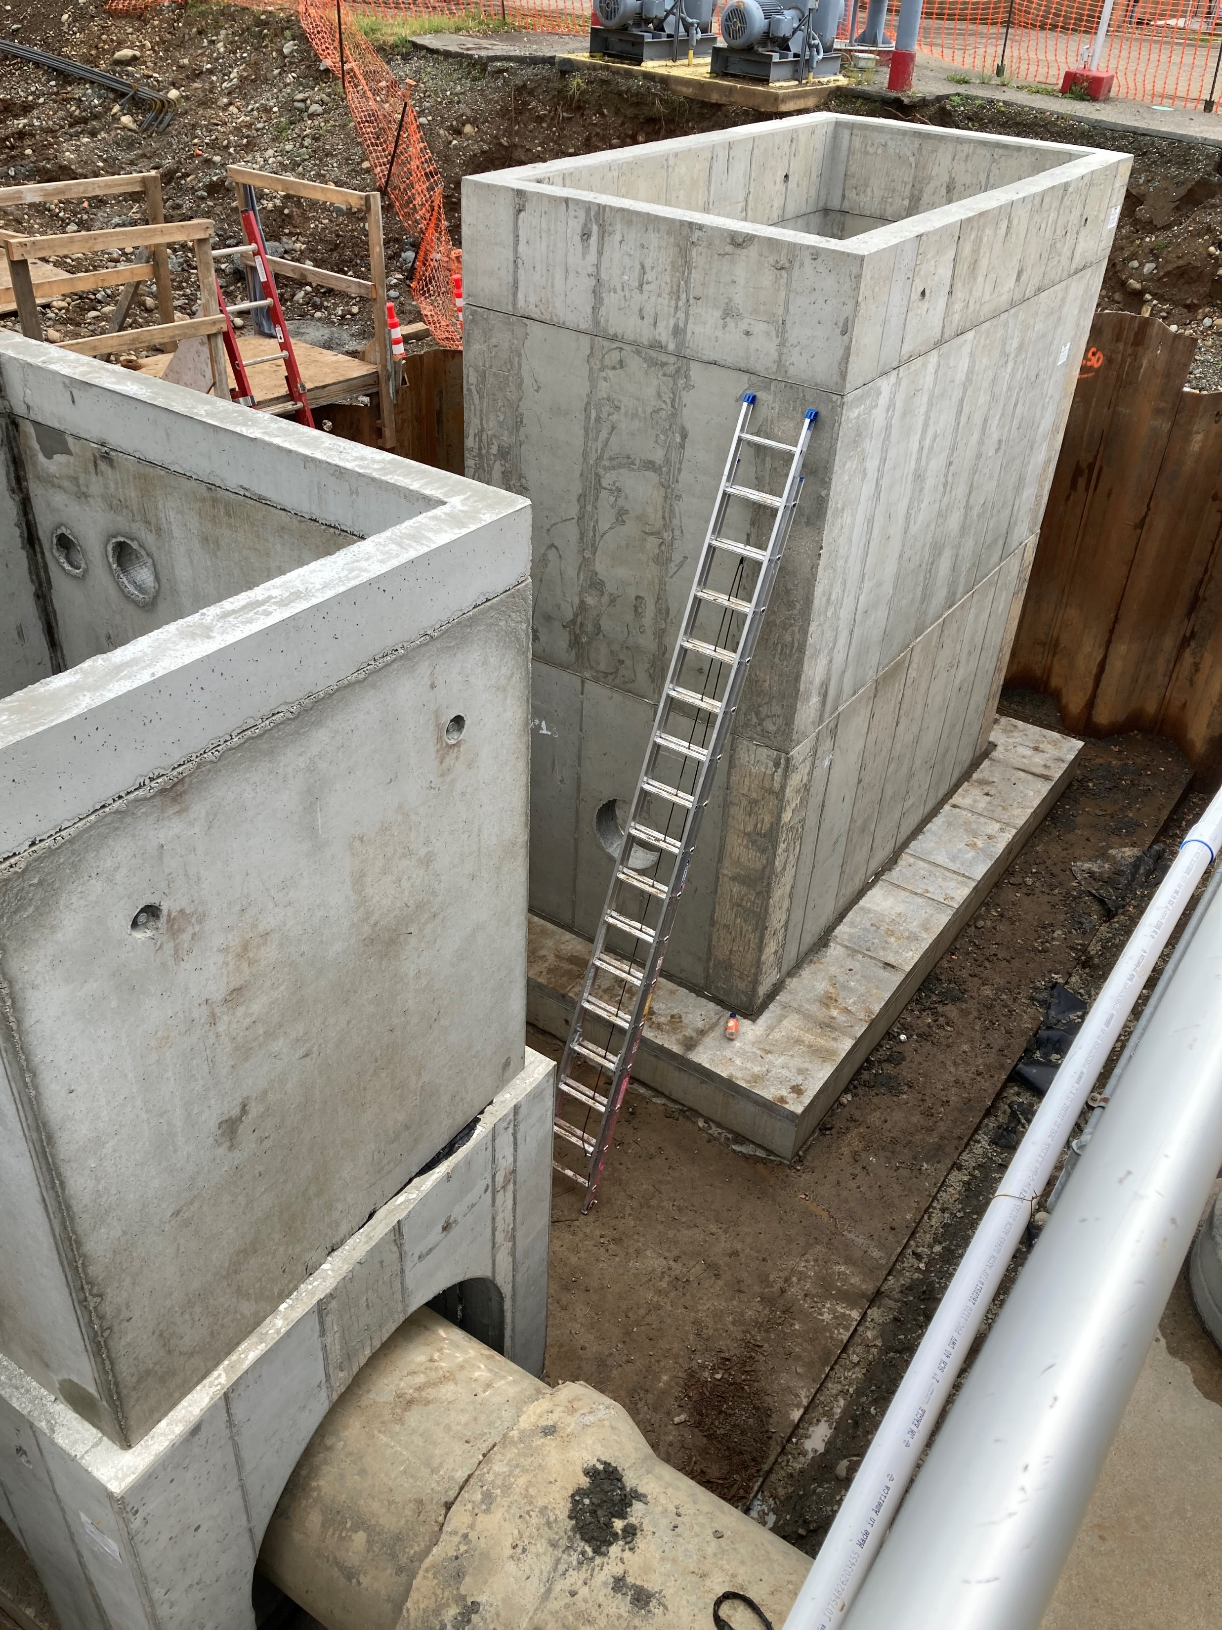
Three New Precast Vaults Ready For Pipework

Slide 7
The Five Vaults Are Set

Slide 8
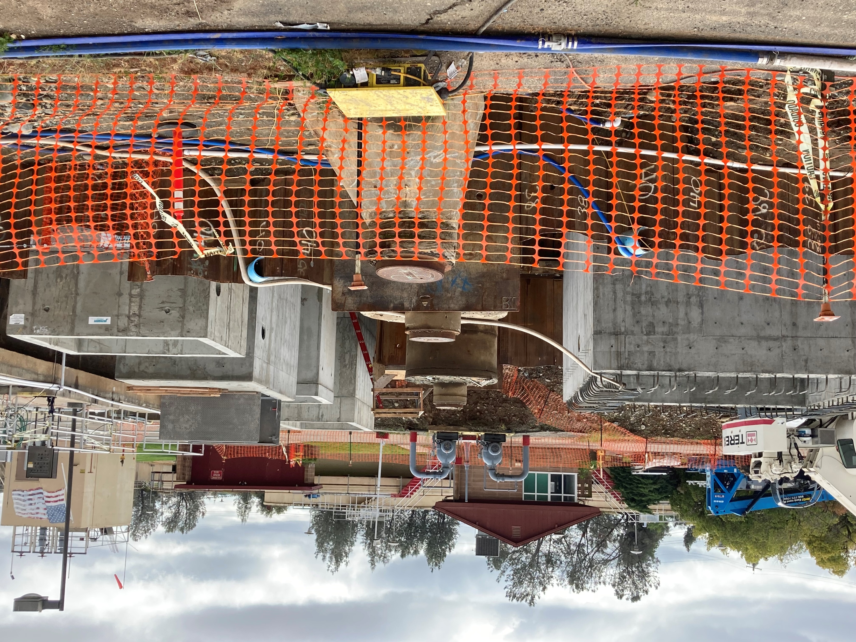
Same Vaults Different Views

